Slide 1
Covid Patients Chest X-Ray Image Interpretation
Fady Smouni
Nidhi Danayak
Deep Learning (Spring II, 2020)
Dr. Youakim Badr

Slide 2
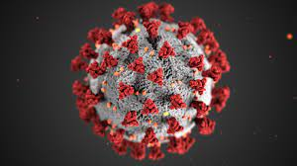
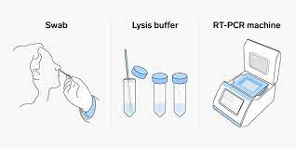
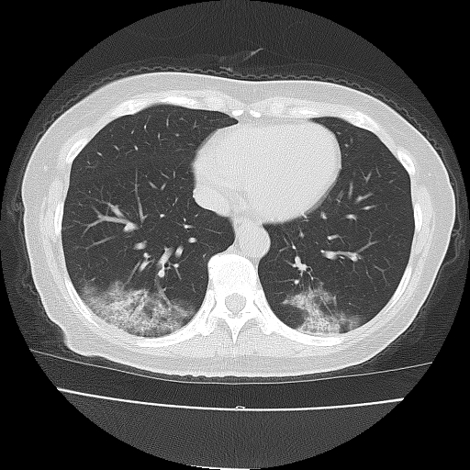
2 min to convince the audience

Slide 3
QUESTION….
HOW CAN WE IMPROVE
THIS SYSTEM
AND SAVE LIVES FASTER?

Slide 4
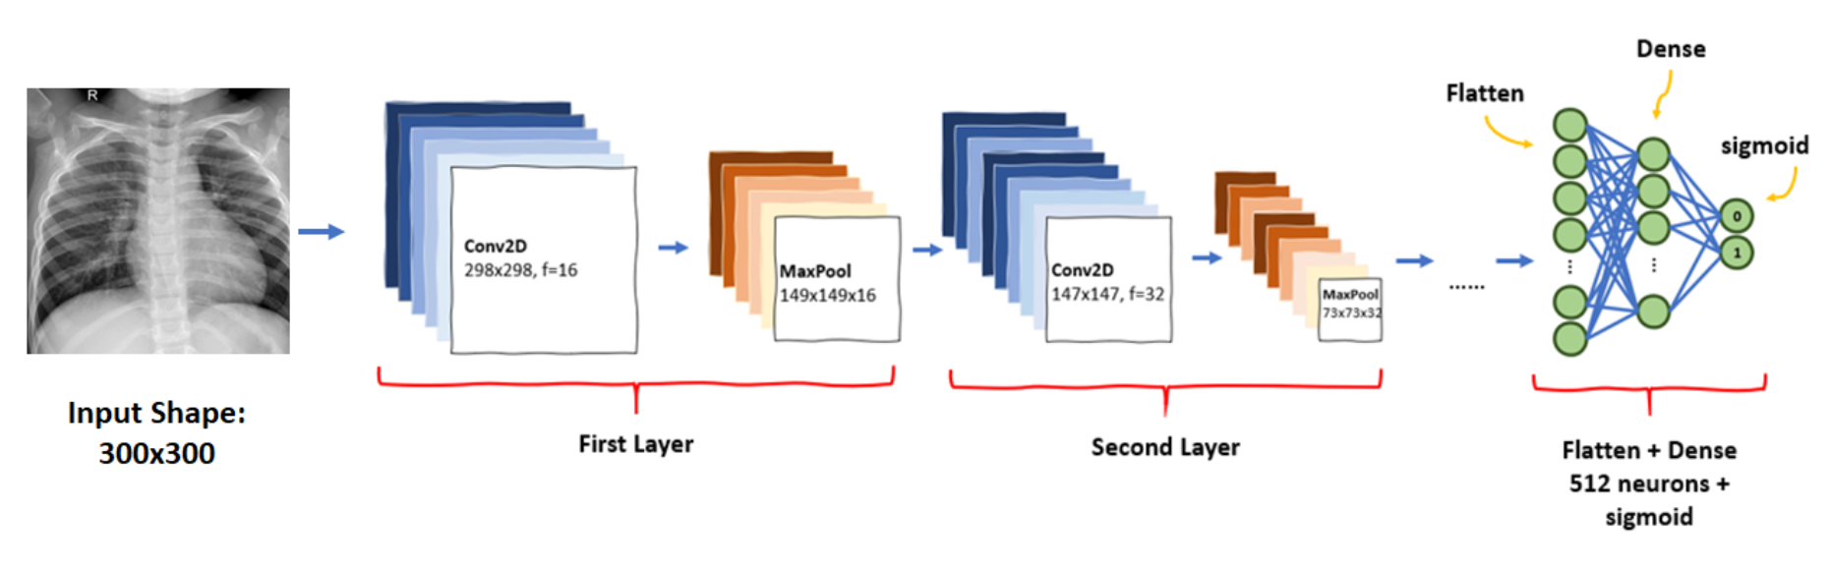

CONVOLUTIONAL
NEURAL NETWORK
TO THE RESCUE

Slide 5
Context and Introduction
Convolutional Neural Network X Chest X-Ray image
19,685 labeled CT slices

Slide 6

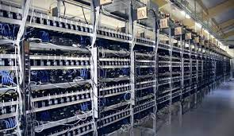
Problem and Challenges
ACCESSIBILITY TO DATA
COMPUTATIONAL RESOURCE’S LIMITATIONS
LACK OF LABELED DATA

Slide 7
Related solutions / State of Art
The dataset was extracted from iCTCF website by Huazhong University of Science and Technology.
They used X-ray images along with each patient’s 130 clinical features to build a novel framework of Hybrid-learning for UnbiaSed predicTion of COVID-19 patients (HUST-19) to predict the outcomes along with the Morbidity and Mortality outcomes.
Besides HUST-19, Inception Net V3 and ChexNet, was also implemented for predicting morbidity and mortality outcome.
Some have investigated the fine tuning of pretrained convolutional neural networks (CNNs) like for this classification.

Slide 8

Overview of Solution / Contributions
99% Accuracy
Differentiate between positive and negative CTs
Future potential to advance collaboration between medical professionals and Deep Learning community

Slide 9
Data Collecting
Source(url): http://ictcf.biocuckoo.cn/HUST-19.php it is an open resource dataset that contains chest computed tomography (CT) from 1170 patients
We are provided with 19,685 manually labeled CT slices. The labeling splits them into 3 categories; non-informative CT (NiCT), positive CT (pCT), negative CT (nCT)
Dataset contains chest CT from 1170 patients
5705 NiCT
4001 pCT
9979 nCT

Slide 10
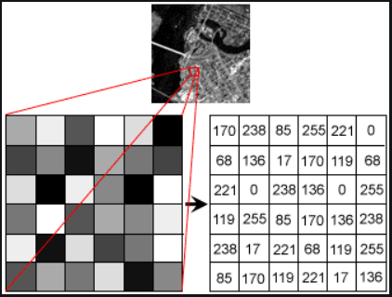
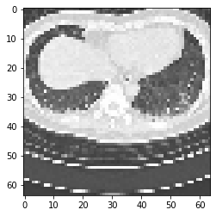
Data Preprocessing
Load images
Resize the images to 64x64.
Extract labels
We also scale the pixels

Slide 11
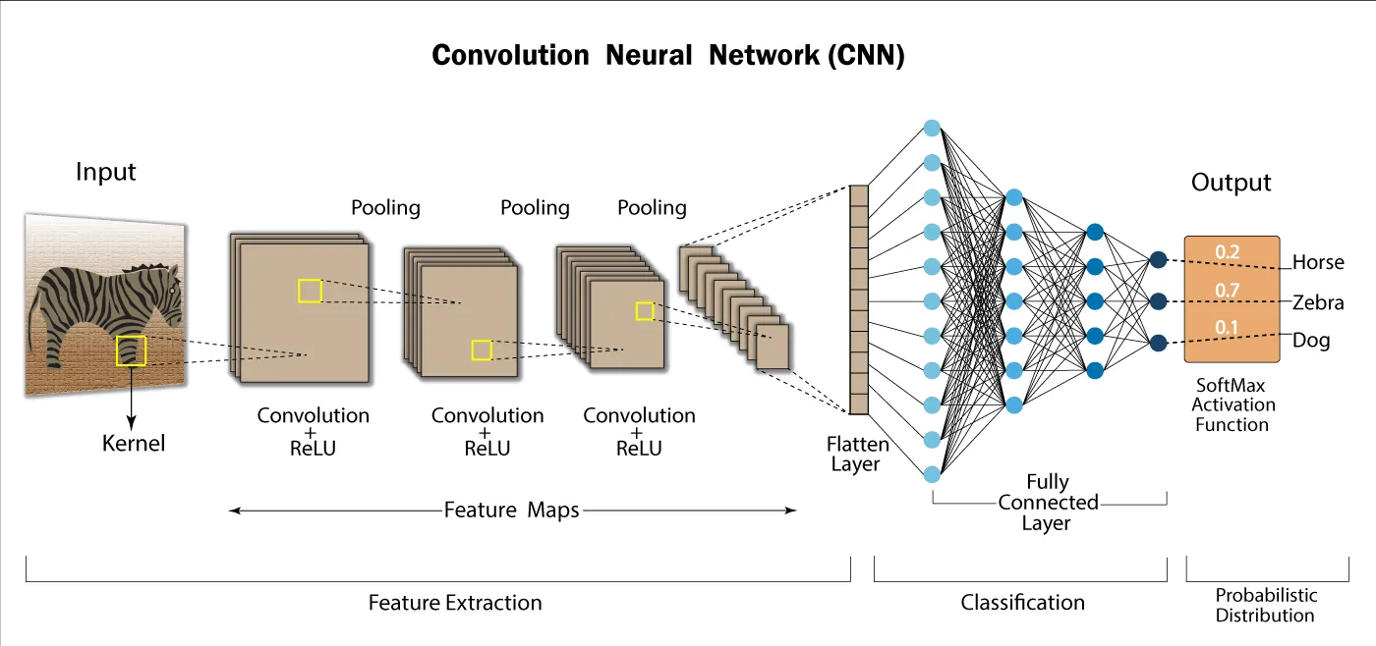
Methodology
In this project, we are going to use convolutional neural networks (CNN or ConvNet)
introduced by Yann LeCun in the late 90s
Grew in popularity around 2012

Slide 12
Models selection and parameters
3 main models
Simple CNN as a baseline
Model based on VGG19 architecture
Model based on transfer training using DenseNet121
Other models used for testing purposes

Slide 13
Simple CNN
Total Parameters | Trainable Parameters | Non-trainable Parameters
1,053,795 | 1,053,795 | 0
model1 = Sequential()
model1.add ((Conv2D(16, (3,3), padding= 'same', input_shape= input_shape)))
model1.add(Activation("relu"))
model1.add(MaxPooling2D(pool_size=(2,2), strides= (2,2)))
model1.add(Activation("relu"))
model1.add(Conv2D(32, (3,3), padding= 'same'))
model1.add(Activation("relu"))
model1.add(Flatten())
model1.add(Dense(32))
model1.add(Dense(classes))
model1.add(Activation("softmax"))

Slide 14
Model based on VGG19 architecture
Total Parameters | Trainable Parameters | Non-trainable Parameters
35,768,387 | 35,768,387 | 0
model = Sequential()
model.add(Conv2D(64, (3,3), padding= 'same', input_shape= input_shape))
model.add(Activation("relu"))
model.add(Conv2D(64, (3,3), padding= 'same'))
model.add(Activation("relu"))
model.add(MaxPooling2D(pool_size=(2,2), strides= (2,2)))
model.add(Conv2D(128, (3,3), padding= 'same'))
model.add(Activation("relu"))
.
.
.
model.add(MaxPooling2D(pool_size=(2,2), strides= (2,2)))
model.add(Flatten())
model.add(Dense(3072))
model.add(Activation("relu"))
model.add(Dropout(0.5))
model.add(Dense(3072))
model.add(Activation("relu"))
model.add(Dropout(0.5))
model.add(Dense(3))
model.add(Activation("softmax"))

Slide 15
DenseNet121 transfer training model
Total Parameters | Trainable Parameters | Non-trainable Parameters
7,037,504 | 6,953,856 | 83,648
modelDenseNet121 = DenseNet121(weights = 'imagenet',
include_top = False,
input_shape = input_shape)
model = Sequential()
model.add(modelDenseNet121)
model.add(Flatten())
model.add(Dense(classes))
model.add(Activation('softmax'))

Slide 16
Network Training
Model | Total Training time
Simple CNN | 12
VGG19 | 64
DenseNet121 | 32
Please keep in mind that these numbers can differ depending on the computational resources you have available

Slide 17
Evaluations – Performance – comparing
 | Precision | Recall
NiCT | 1 | 0.71
nCT | 0.89 | 0.97
pCT | 0.74 | 0.98
Simple CNN
VGG19 architecture model
 | Precision | Recall
NiCT | 1 | 0.98
nCT | 0.99 | 0.99
pCT | 0.97 | 1
DenseNet121 transfer training model
 | Precision | Recall
NiCT | 1.00 | 0.99
nCT | 0.98 | 0.99
pCT | 0.97 | 0.98
Notes:
We can see that both VGG19 and DenseNet121 perform very well on all metrics.

Slide 18
Evaluations – Performance – comparing (2)
Model | Accuracy
Simple CNN | 0.87
VGG19 architecture model | 0.99
DenseNet121 transfer training model | 0.99

Slide 19
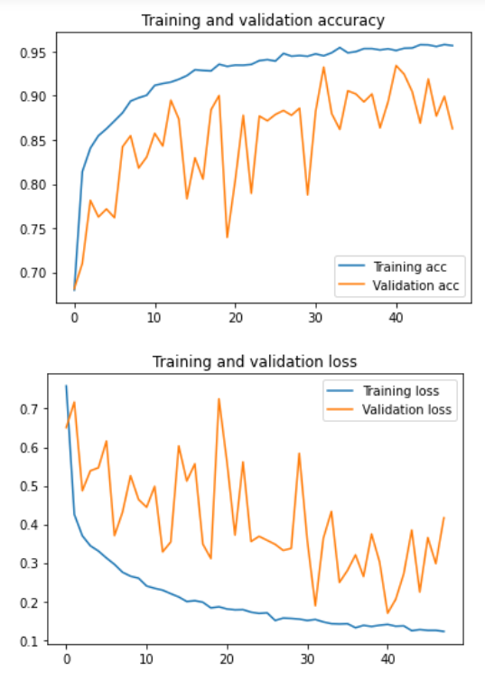
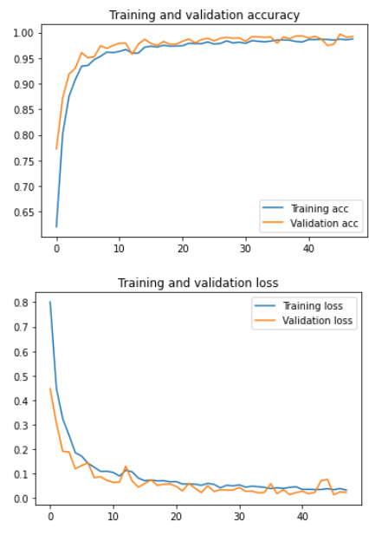
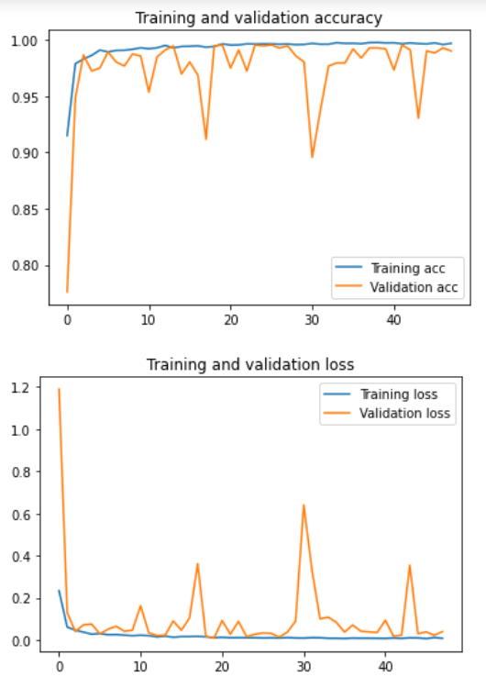
Evaluations – Performance – comparing (2)
Simple CNN
VGG19
DenseNet121

Slide 20
Outcomes/finding
Many state of the art CNN architectures available to tune and fit to different image classification problems
We are able to make predictions on positivity to COVID-19.
Importance of large datasets
Importance to work with medical professionals to bridge the gap with the deep learning community
Ability to provide in the long run a minimum level of care around the world that matches the ability of Deep Learning methods to make inferences that doctors make now.

Slide 21
Lessons learned and Perspectives
Deep Neural Networks are resource intensive
Use pretrained models

Slide 22
Future Steps
Clinical patient data
Predict severity of cases
Combine the imaging prediction with Clinical data severity prediction to predict mortality.

Slide 23
Bibliographical References
[1] Chester: A Web Delivered Locally Computed Chest X-ray Disease Prediction System
[2] COVID-Net: a tailored deep convolutional neural network design for detection of COVID-19 cases from chest X-ray images
[3] Classification of COVID-19 chest X-rays with deep learning: new models or fine tuning?
[4] Unveiling COVID-19 from CHEST X-Ray with Deep Learning: A Hurdles Race with Small Data
[5]ChestX-ray: Hospital-scale Chest X-ray Database and Benchmarks on Weakly-Supervised Classification and Localization of Common Thorax Diseases

